Slide 1
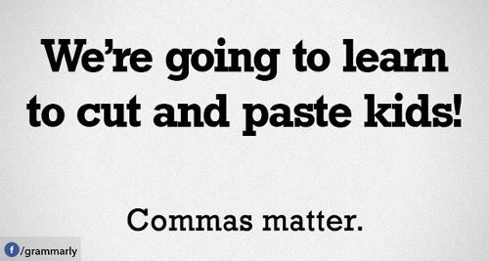
ACT Comma practice
Lopez/Oakley – English 5-6

Slide 2
Pre-Practice
The soft, blue cloth slid through her fingers easily.
NO CHANGE
blue, cloth slid through
blue cloth slid, through
blue cloth, slid through
After hearing good things about it, I wanted to read Crime and Punishment, but the book, itself, turned out to be super boring.
NO CHANGE
the book itself,
the book itself
itself
Talking to my friends, on the phone, is one of my favorite things to do.
NO CHANGE
friends on the phone
friends on the phone,
friends on, the phone
I wasn't planning on going to the wedding, however you've convinced me that it's a good idea.
NO CHANGE
wedding. however,
wedding, however,
wedding,

Slide 3
Pre-Practice ANSwers
The soft, blue cloth slid through her fingers easily.
NO CHANGE
blue, cloth slid through
blue cloth slid, through
blue cloth, slid through
After hearing good things about it, I wanted to read Crime and Punishment, but the book, itself, turned out to be super boring.
NO CHANGE
the book itself,
the book itself
itself
Talking to my friends, on the phone, is one of my favorite things to do.
NO CHANGE
friends on the phone
friends on the phone,
friends on, the phone
I wasn't planning on going to the wedding, however you've convinced me that it's a good idea.
NO CHANGE
wedding. however,
wedding, however,
wedding,

Slide 4
RULE #1: when in doubt, leave it out
The single most important rule to keep in mind when dealing with commas on the ACT:
If you aren't sure if you need a comma, you probably don't need a comma.

Slide 5
RULE #1: when in doubt, leave it out
In this question, the answer is….
D
Write this sentence out with no commas and you get "Perhaps this legacy of letters explains what she meant when she said that her friends were her 'estate.'" Again, it makes sense without either comma, so D is the correct choice.

Slide 6
RULE #2: Appositives, Relative Clauses, and Interjections
As a general rule, any part of a sentence that can be removed without changing the sentence's fundamental meaning must be bracketed by commas.

Slide 7
RULE #2: Appositives, Relative Clauses, and Interjections
Appositive Phrase – describes a noun/pronoun
Timmy who loves Superman is excited for the upcoming movie.
Timmy who loves Superman is excited for the upcoming movie.
Timmy, who loves Superman, is excited for the upcoming movie.

Slide 8
RULE #2: Appositives, Relative Clauses, and Interjections
Ernest Hemingway an author wrote nine novels.
Ernest Hemingway an author wrote nine novels.
Ernest Hemingway, an author, wrote nine novels.

Slide 9
RULE #2: Appositives, Relative Clauses, and Interjections
Version 1: However, my sister refused to help me move the couch.
Version 2: My sister, however, refused to help me move the couch.

Slide 10
RULE #3: Introductions
The basic rule for using commas with introductions is that any time a sentence starts with a dependent clause or modifying phrase, it must be followed by a comma.

Slide 11
RULE #3: Introductions
Even though I was tired, Jenny convinced me to go to the strawberry festival.
In the library, she found the books she needed.
Weird-looking as it was, the lizard was sort of cute.

